Slide 1
CE899- Individual Project
PHRUGSA LIMBUNLOM (2311569)

Slide 2
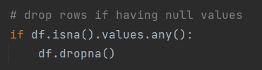
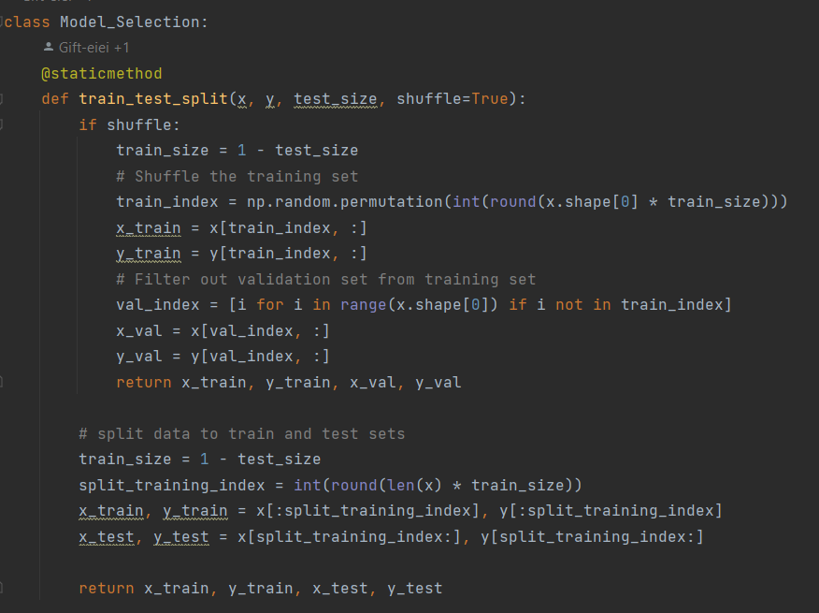
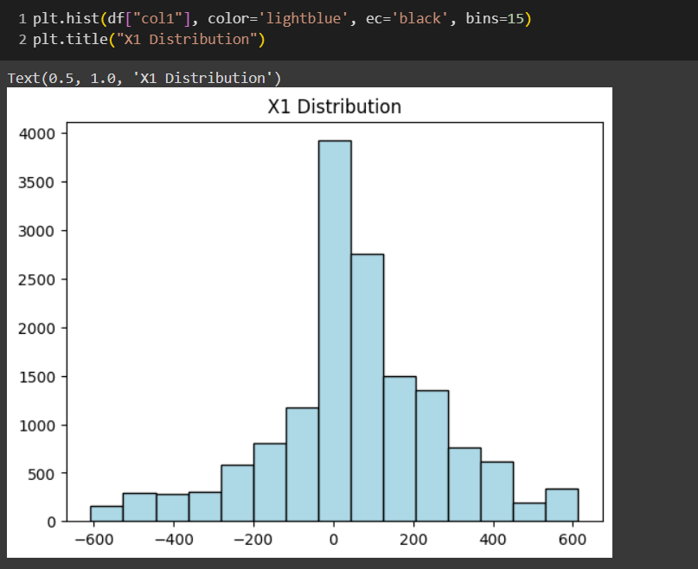
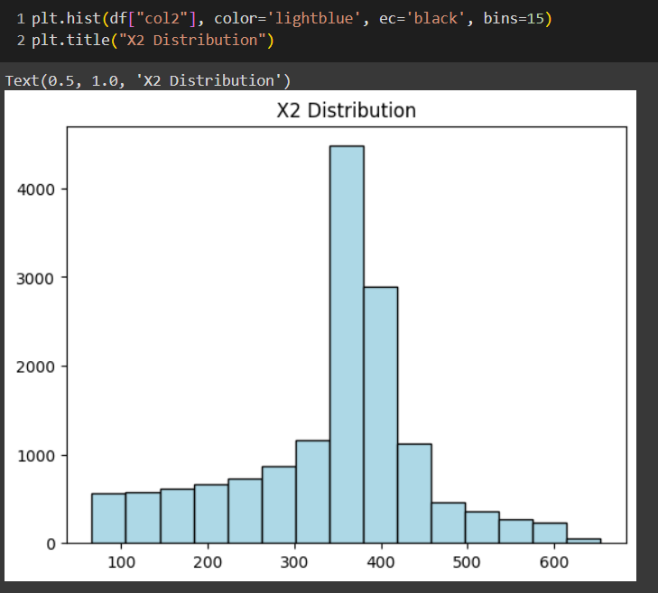
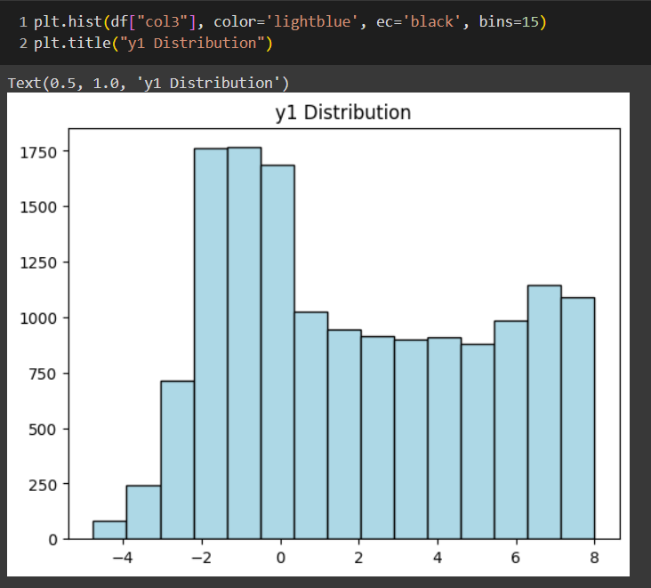
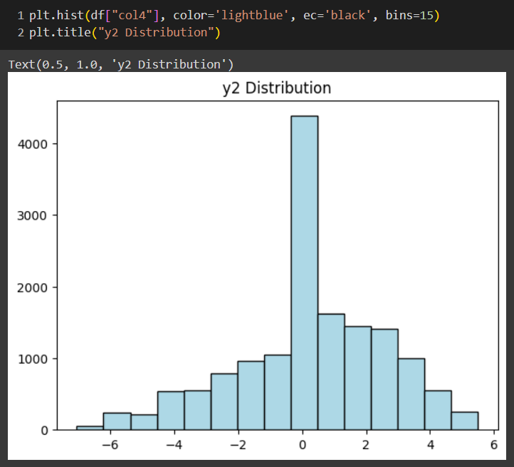
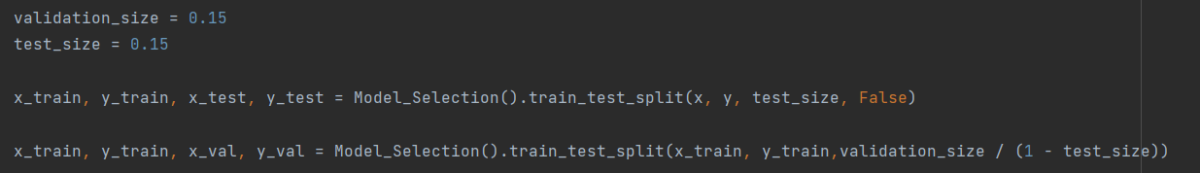
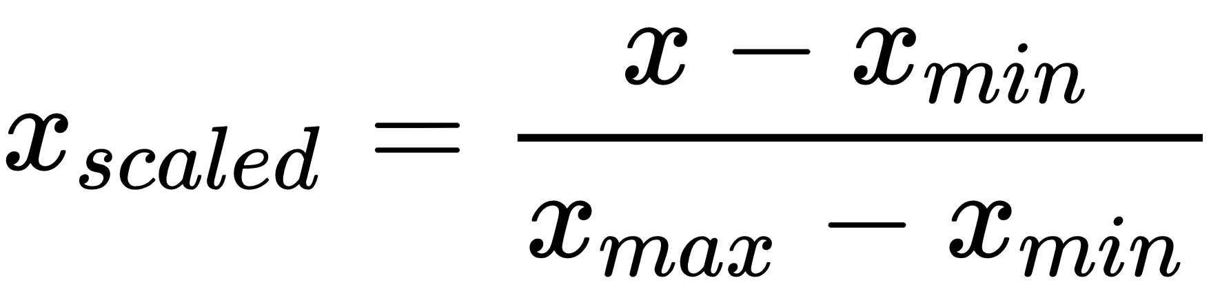

Data
Pre-processing
Train = 10,529
Validation = 2,256
Test = 2,256
Drop Missing Value (If have)
Data set = 15,041
Validate distribution
Min-Max Normalization (0-1)

Slide 3
Architecture
Rule of thumb
Hidden size is 2/3 of Input neurons + Output neurons
Validation Loss: 0.23579883
Validation Loss: 0.23143938
Validation Loss: 0.23074882
Input neuron size -> x inputs
Output neuron size -> y outputs

Slide 4
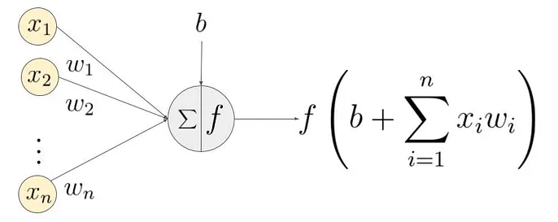
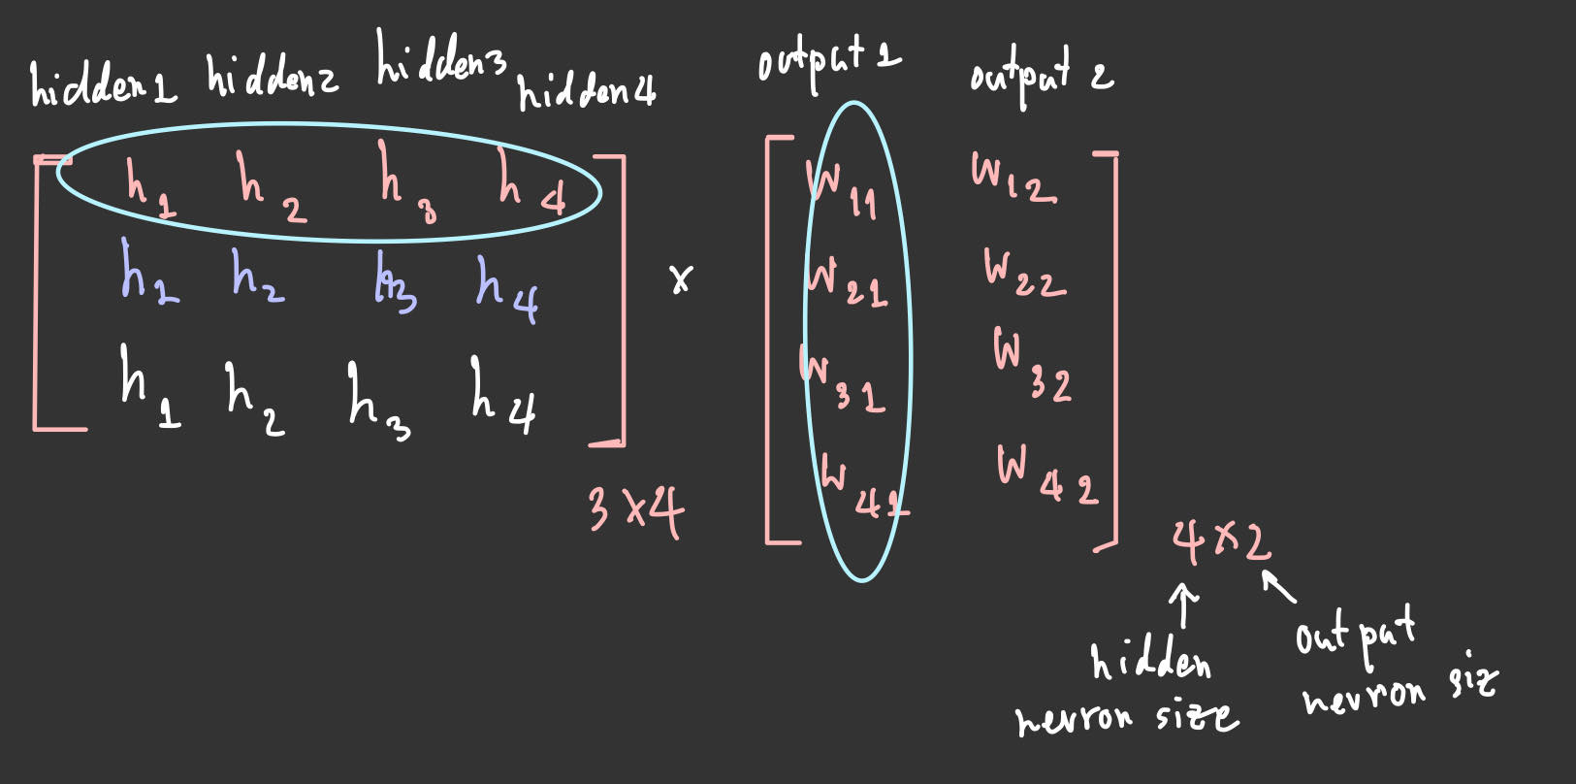
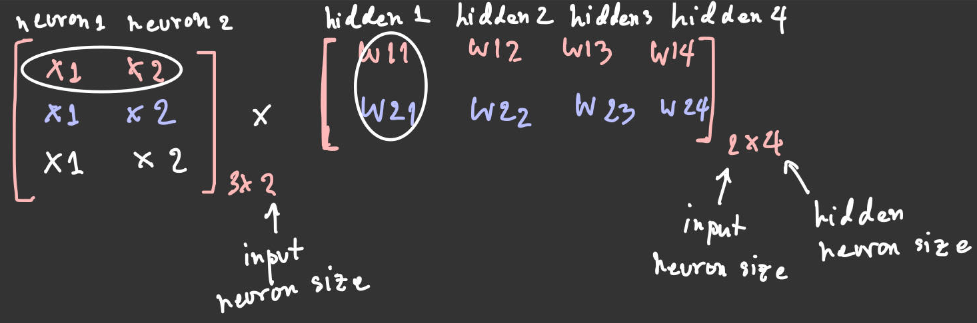
w11
Y1
X1
w12
w13
w14
X2
Y2
b
b
Iteration 1
(X1*W11)+(X2*W21) | (X1*W12)+(X2*W22) | (X1*W13)+(X2*W23) | (X1*W14)+(X2*W24)
(X1*W11)+(X2*W21) | (X1*W12)+(X2*W22) | (X1*W13)+(X2*W23) | (X1*W14)+(X2*W24)
(X1*W11)+(X2*W21) | (X1*W12)+(X2*W22) | (X1*W13)+(X2*W23) | (X1*W14)+(X2*W24)
Iteration 2
wb1 | wb2 | wb3 | wb4
Iteration 3
https://medium.com/coinmonks/the-mathematics-of-neural-network-60a112dd3e05

Slide 5
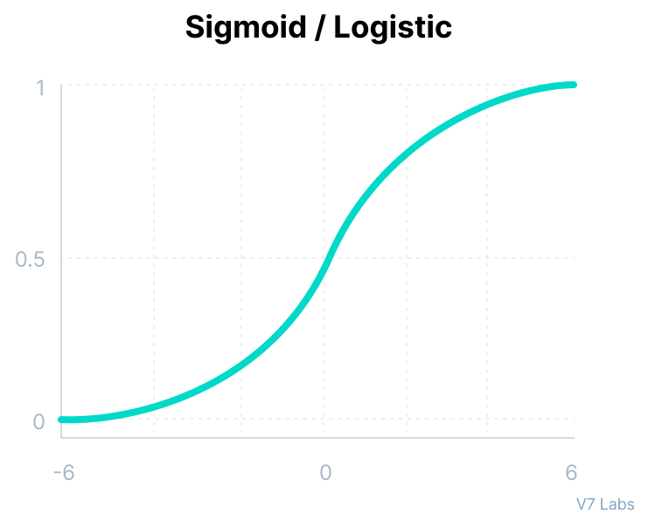
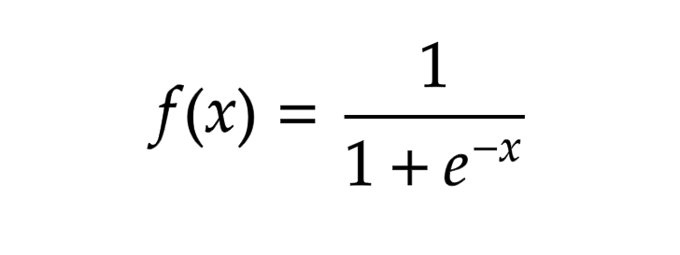
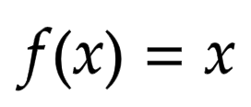
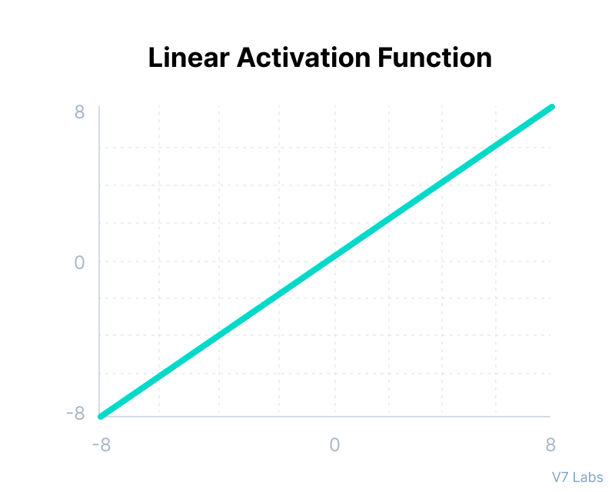
w11
Y1
X1
w12
w13
w14
Y2
X2
b
b
https://www.v7labs.com/blog/neural-networks-activation-functions

Slide 6
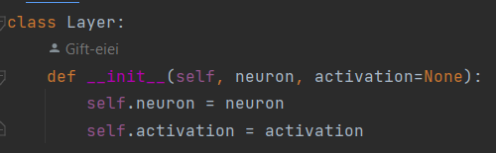
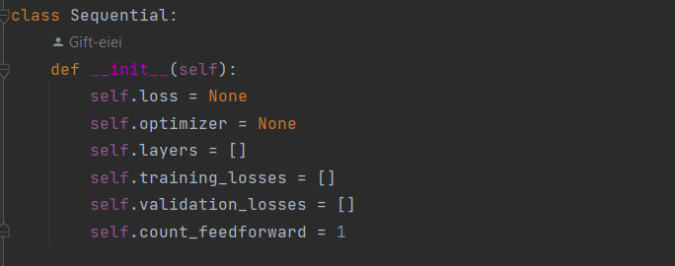

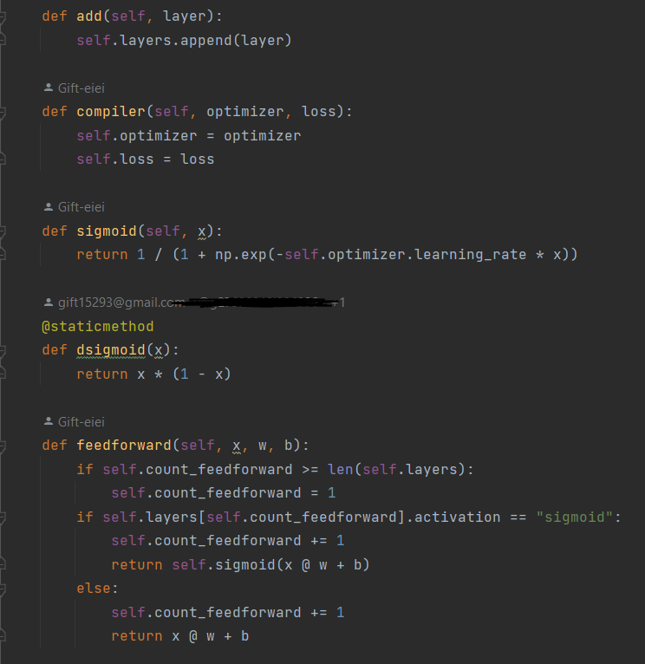
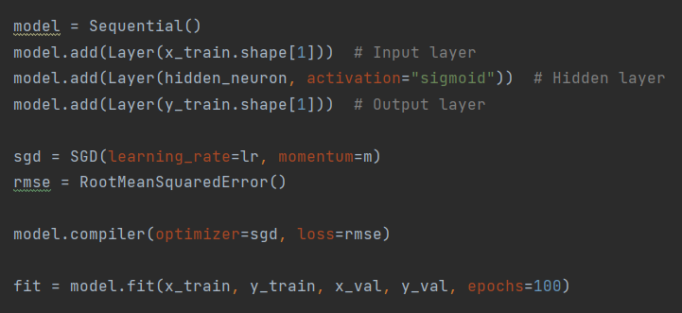

Slide 7
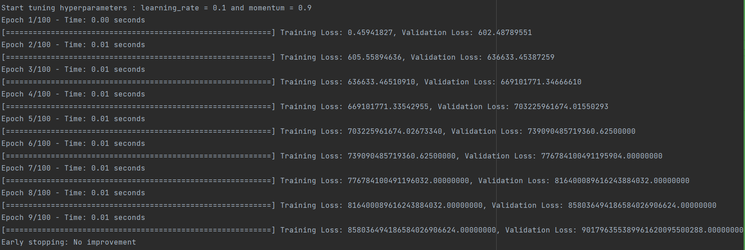

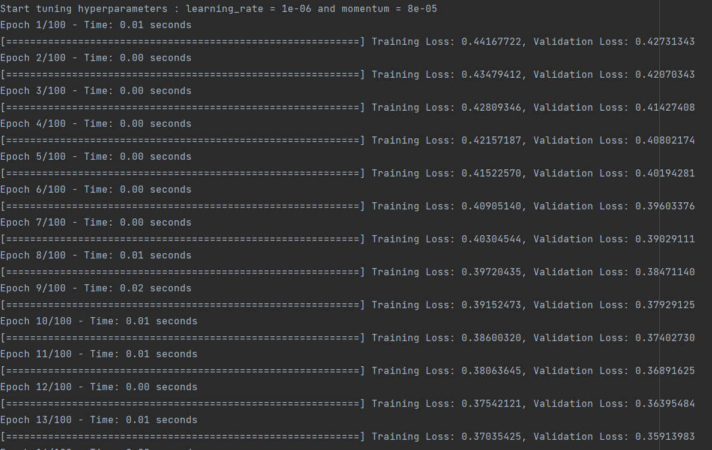

Parameters
Learning rate = 0.1 , Momentum = 0.9 --> Loss increases
Hyperparameters Tuning
-> Grid search
6 X 6 = 36 combination
Learning rate = 1e-6 , Momentum = 8e-5
--> Loss decreases

Slide 8
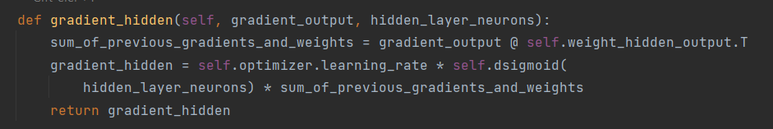
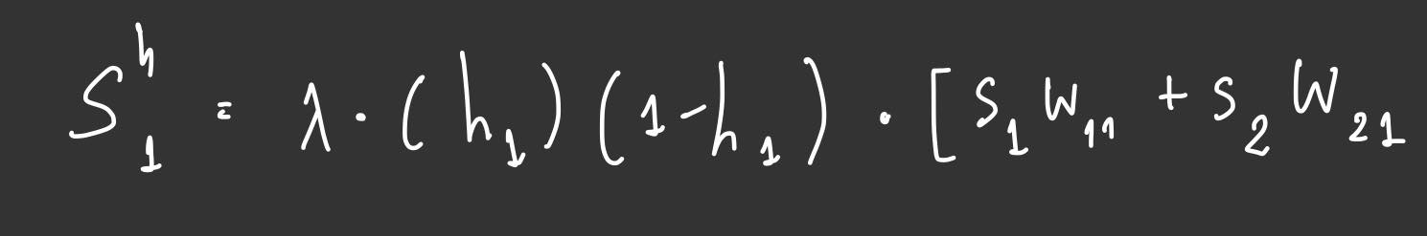
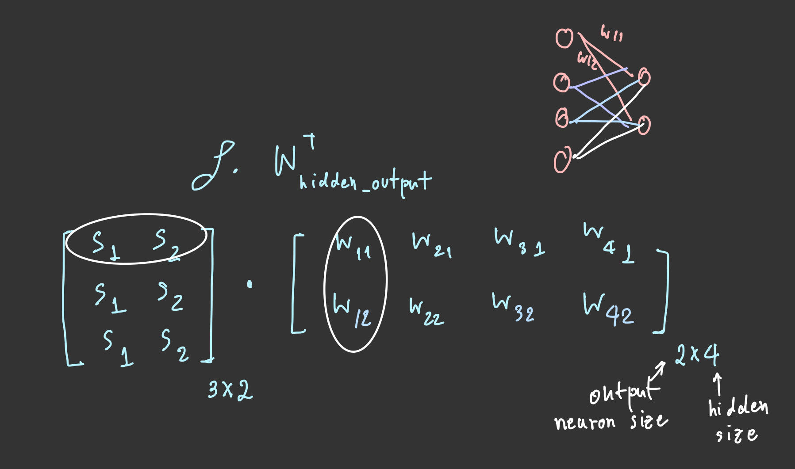


Slide 9
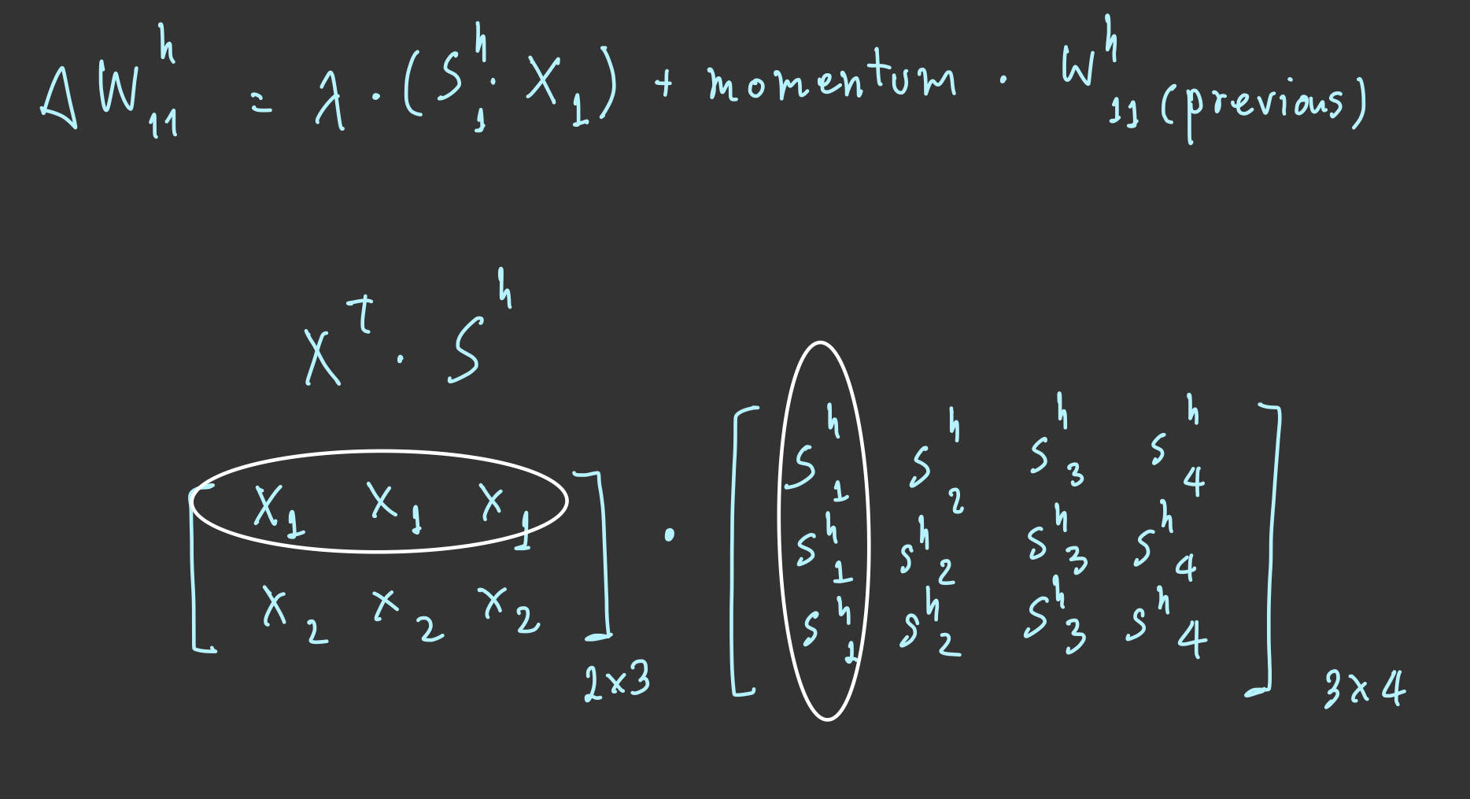
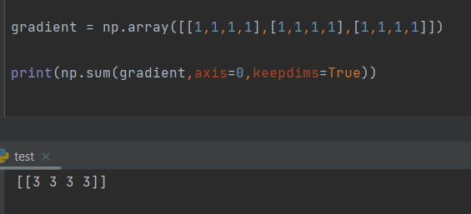

Slide 10
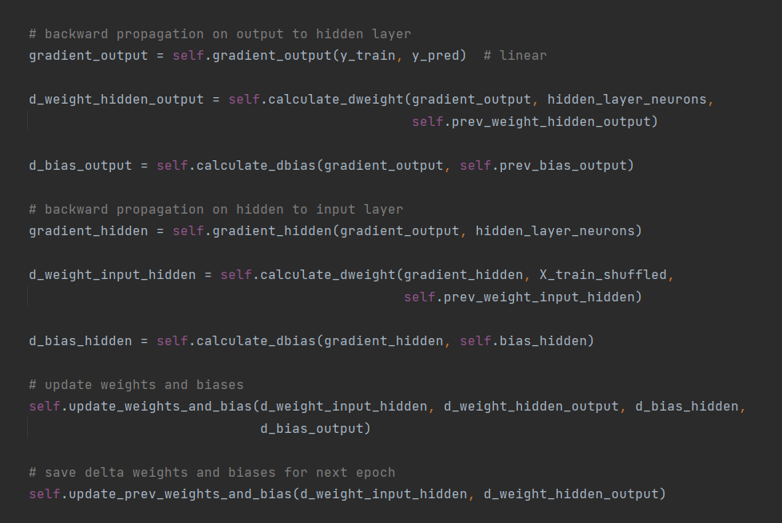

Slide 11
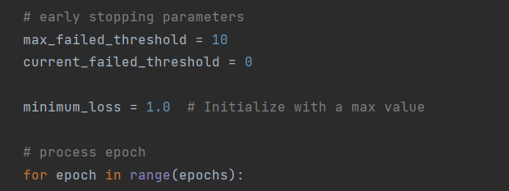
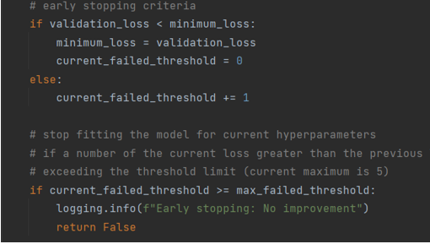
Early Stopping
Loop epochs
if the validation loss is less than the previous validation loss
set current failed threshold to 0
else
set current failed threshold increment by 1
if the current failed threshold is greater than or equal to the maximum failed threshold
this is early stopping! (stop training)
loop break

Slide 12
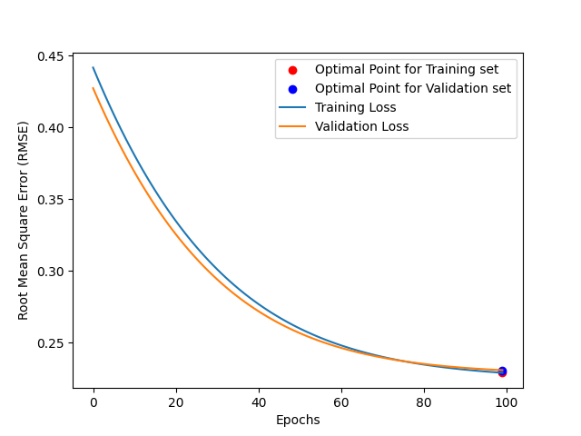

RMSE

Slide 13
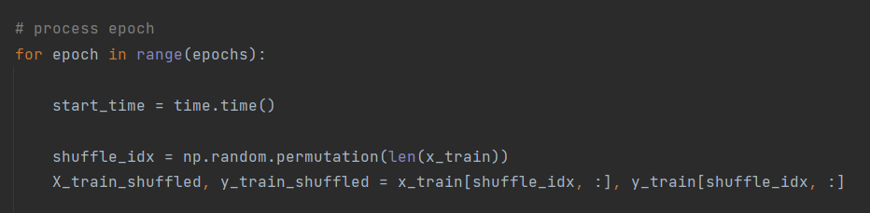
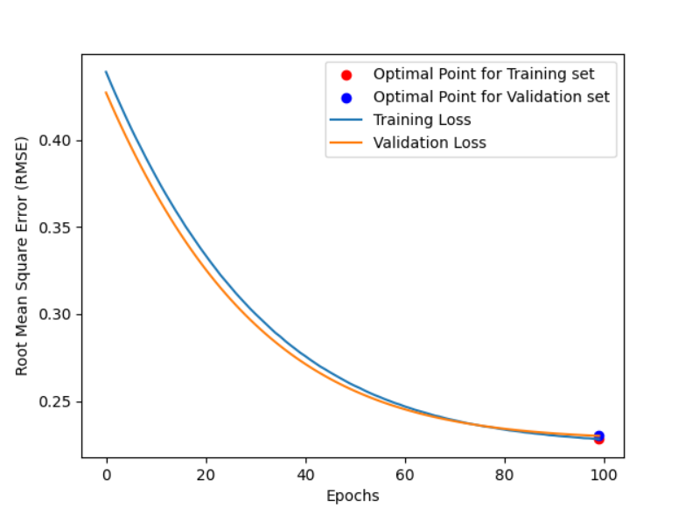
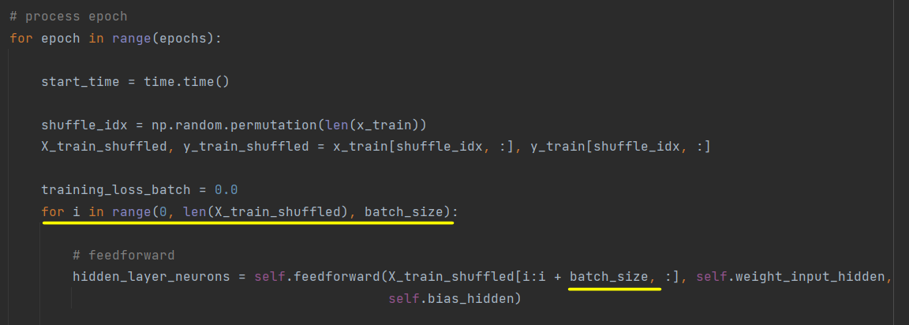
Anything else
Shuffle Index of training data set before training model in each epoch
Having another code version to iterate the batch size for each epoch
RMSE Loss when using Batch

